Slide 1
Period.

Slide 2


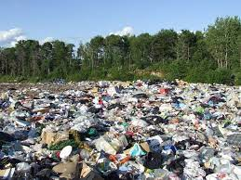

The problem
3 billions
9 billions
12 billions plastic pads per year in India
Notes:
Soil Pollution
Water Contamination
Loss of Marine Life
This is because there is not waste management system everywhere for sanitary napkins. However the recocmmndation from LCA and analysis says that even with a proper waste management system in place, the most sustainable practices is stil not plastic sanitary naplings . It’s the 2 following options.

Slide 3
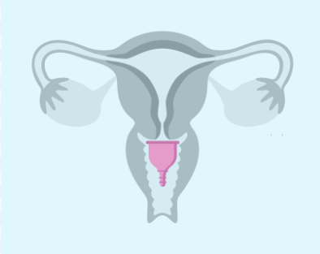

Closing the tap
Menstrual cup
Reusable sanitary napkins
Notes:
Reserach has shownb that the best is mesntrual cup and reusable sanitary napkins

Slide 4
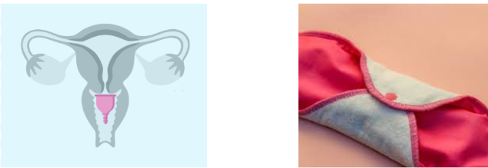




Changing behaviors
Unaware : negative environmental impact + the existence of alternatives
Fear for their health and for their virginity
Cost barrier
Accessibility
Notes:
Awareness about the environmental issue
Personnalized reccommendation
Question and answer science and their local “influencers”
Free product to try
Delivered at their home

Slide 5



Our Solution-PERIOD.
ONLINE PLATFORM
OFFLINE AWARENESS
Educational material on sustainable menstrual practices
Awareness material on breaking the taboo
Test based customized solution
Access to eco-friendly menstrual product
Support to local manufacturers
Enhance Awareness
Educational sessions in community centres
Broadcasting through local influencers
Awareness sessions with men on breaking the taboo
Access to free eco-friendly products

Slide 6
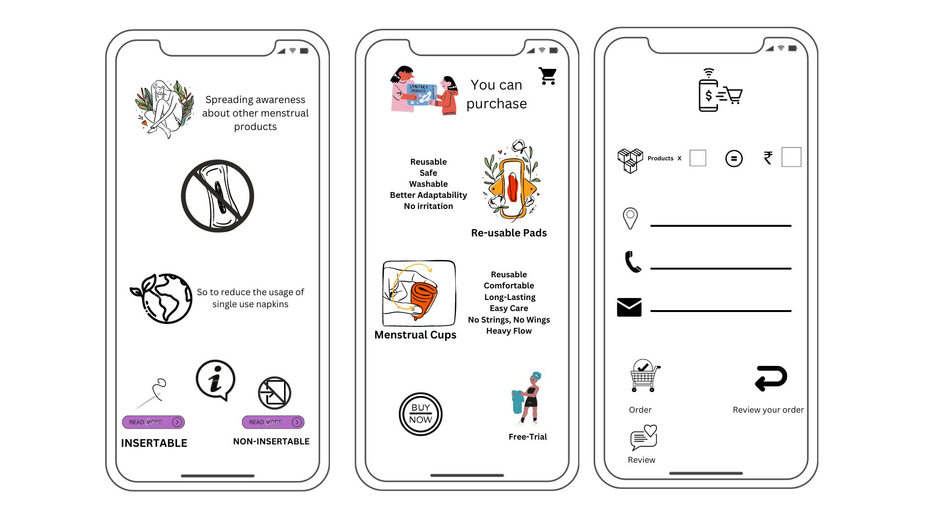
Online platform Prototype
Platform features
User-Friendly
Available in local languages
Free educational material offline/online

Slide 7



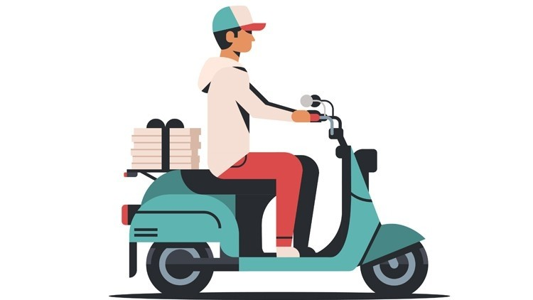



Customer Journey-Online Platform
Customer takes a test
Access to online platform
Gets access to customized available solution and educational material
Period.
Customer gets free product/ link to option to buy
Packaging Box having labels of both companies
Customer Feedback
Geography based
Local Manufacturers
Notes:
Creating a movement /brand Ambassadors Verified information= trust Free first try Delivered at your home

Slide 8
Our social enterprise business model
Key Partnership
Manufacturers of sustainable sanitary products.
Influencers (community ambassadors, religious leaders,
Key Activities
Build partnerships with local producers of sustainable menstrual products.
Build partnerships with local influencers
Build online platform
Market the online platform
Value proposition
Enhanced Awareness towards eco-friendly products
Easy access to eco-friendly products
Reduce the existing taboos and stigma
Enhance quality of life of menstruators
Reduce the negative ecological impact of existing plastic based solutions on the planet
Customer relationship
Credible menstrual educational materials
Access to the most suitable sanitary product
Customer segment
Menstruators in India who do not use sustainable menstrual products
Teachers, educators, influencers
Channel
Online- education/purchase/delivery
Offline- education/purchase/delivery
Key resources
Access to partnership
Connection to customers
Cost structure
Hosting of the online platform
Platform design cost
Offline awareness creation- influencers
Revenue streams
% of the sales after free trial

Slide 9






Impact on the SDGS
Contribute to target 14.7 Reduce plastic debris in rivers and oceans
Contribute to target 15.3 Reduce the proportion of land that is degraded by sanitary waste.

Slide 10



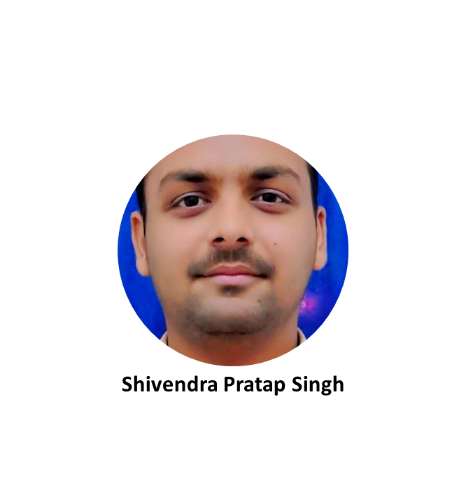
It’s time to act for the environment
PERIOD.
MEET THE TEAM

